Slide 1
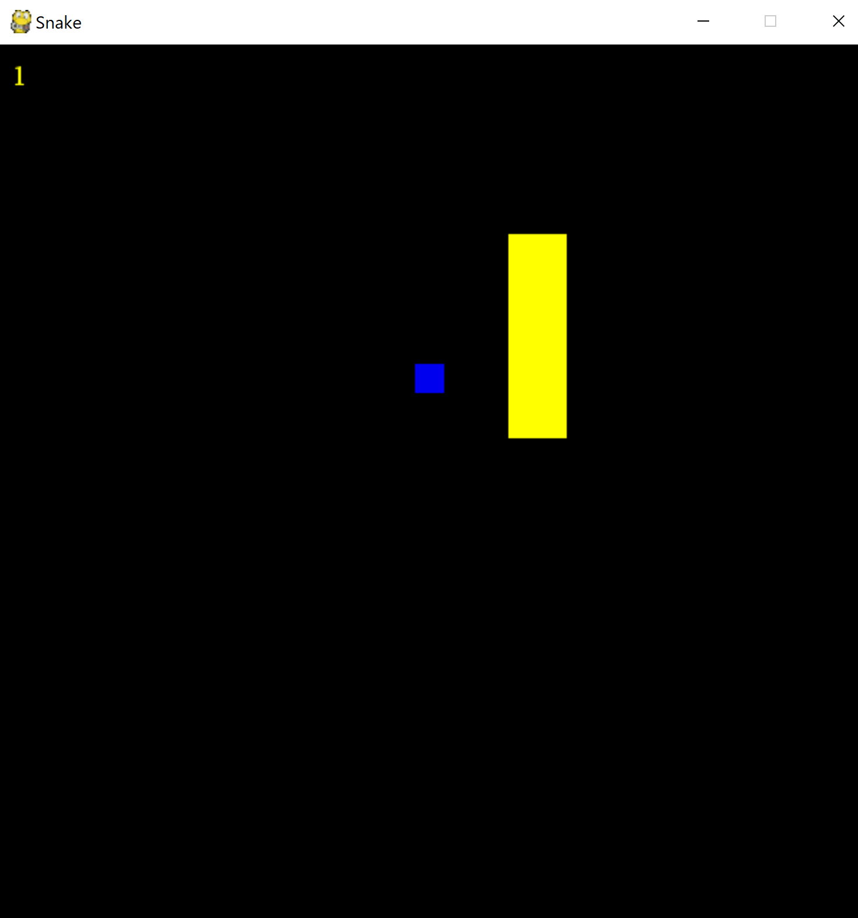

Snake game
Developer: Jonathan Grizzle
Original Developer: Samuel BackMan
A simple mind-numbing game meant to bring back 90s nostalgia.

